Slide 1
AI-Driven IoT for Smart Waste Management Systems
By Chisom Nwanonenyi and Naomi Berumen
ITAI 3377 – Capstone Project
Instructor: Patricia McManus

Slide 2
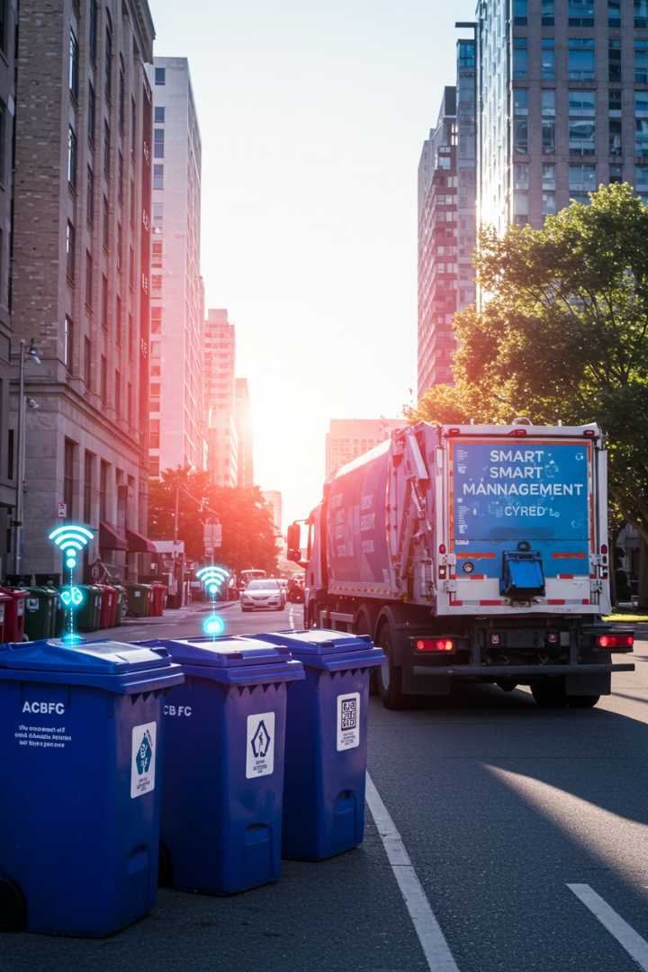
AI-Driven IoT for Smart Waste Management Systems
In today's rapidly urbanizing world, waste management has emerged as a critical challenge with far-reaching environmental, economic, and public health implications. Traditional waste collection systems often operate inefficiently, resulting in overflowing bins, excessive fuel consumption, and high operational costs.
This presentation explores how the integration of Artificial Intelligence (AI) and the Industrial Internet of Things (IoT) can revolutionize waste management through predictive analytics, real-time monitoring, and autonomous decision-making. We'll examine the conceptual framework, security considerations, ethical implications, and real-world applications of this transformative technology.

Slide 3





The Current Waste Management Challenge
Inefficient Collection
High Operational Costs
Traditional systems follow fixed schedules regardless of bin fullness, leading to unnecessary trips for nearly empty bins and delayed collection for overflowing ones.
Fuel consumption, labor costs, and vehicle maintenance create significant financial burdens for municipalities and waste management companies.
Environmental Impact
Limited Data Insights
Inefficient routing increases carbon emissions, while overflowing bins contribute to litter, pollution, and public health hazards in urban environments.
Conventional systems lack the ability to analyze waste generation patterns or optimize operations based on historical and real-time data.

Slide 4





Literature Review: Recent Advancements
Smart Bin Design (Kuzhin, 2024)
IoT-based bins with fill-level sensors and AI scheduling algorithms reduced operational costs by 30% through optimized collection routes.
Predictive Analytics (Dubey & Kour, 2025)
Machine learning models successfully predicted waste generation patterns based on historical data and weather conditions, enabling proactive management.
Security Vulnerabilities (Brighente et al., 2023)
Research identified risks in IoT waste management networks, including data manipulation that could misroute collections or generate false alerts.
Adaptation Limitations (Fuqaha & Nursetiawan, 2025)
Many existing systems lack real-time adaptability during unexpected events like festivals or natural disasters, highlighting the need for dynamic responsiveness.

Slide 5










Proposed AI-IoT Architecture
User Interface Layer
Municipal dashboards and citizen reporting apps
Fleet Management System
AI-optimized dynamic routing
Cloud-Based AI Platform
Predictive analytics and machine learning
Edge Computing Gateways
Local data analysis for immediate responses
Smart Bins and Containers
Weight, gas emission, and fill-level sensors
This five-layer architecture creates a comprehensive system where sensors collect real-time data from waste containers, edge computing provides immediate local processing, and cloud-based AI enables advanced analytics and optimization. The fleet management system coordinates efficient waste collection, while the user interface layer keeps stakeholders informed and engaged.

Slide 6
Security and Ethical Considerations
Security Risks
Ethical Concerns
Data interception during transmission
Privacy infringement through sensors
Device hijacking of smart bins
Bias in AI analysis against neighborhoods
Cloud platform vulnerabilities
Data ownership and consent issues
Denial of service attacks
Digital divide in access to services
Mitigation Strategies
Ethical Safeguards
End-to-end encryption protocols
Transparent data collection policies
Secure device authentication
Data anonymization protocols
Regular firmware updates
Regular bias audits of AI models
Redundant backup systems
Inclusive design principles

Slide 7








Feasibility and Economic Analysis
Hardware Considerations
Network Infrastructure
Sensors must withstand harsh environments, including weather extremes, vandalism, and exposure to various waste materials.
Rural and underserved areas face limited 5G/LoRaWAN coverage, requiring strategic deployment of alternative connectivity solutions.
Economic Impact
AI Maintenance
Initial costs range from $200-$500 per smart bin, with potential operational savings of up to 40% over five years and ROI within 2-4 years.
Predictive models require periodic retraining and optimization to maintain accuracy as waste patterns evolve over time.

Slide 8
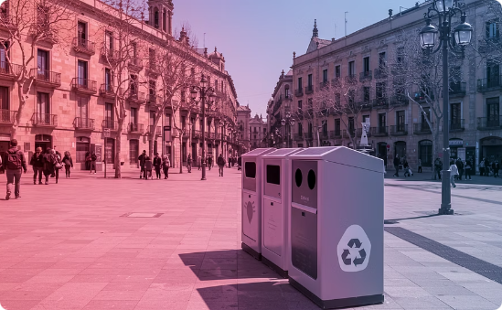

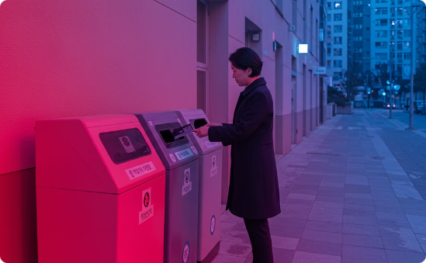
Real-World Implementation Success Stories
Barcelona, Spain
Singapore
Seoul, South Korea
Barcelona deployed a network of smart bins equipped with ultrasonic fill-level sensors and solar-powered compactors. This system optimized collection routes based on real-time data, achieving a remarkable 25% reduction in operating costs and significantly reducing truck traffic in congested urban areas.
Singapore established a comprehensive Smart Waste Management System utilizing RFID tracking, pneumatic waste conveyance, and AI-driven route optimization. The system integrates with the broader Smart Nation initiative, creating synergies with other urban management systems and providing valuable data for city planning.
Seoul implemented RFID-based smart bins specifically for food waste management. Citizens use RFID cards to access and pay for disposal based on weight, creating financial incentives for waste reduction. The system combines citizen participation with real-time monitoring, resulting in a 30% decrease in food waste.

Slide 9
Conclusion and Future Directions
Future Research Focus
Community Engagement
Secure-by-Design Approach
Explore self-healing IoT networks, multi-agent AI systems for comprehensive waste stream management, and integration with broader smart city platforms for synergistic benefits across urban services.
Phased Implementation
Develop comprehensive public communication strategies to build trust, address privacy concerns, and encourage participation in smart waste management initiatives through education and transparency.
Prioritize cybersecurity from the initial design phase through robust network protections, end-to-end encryption, and regular security audits to protect against emerging threats and vulnerabilities.
Begin with pilot programs in urban areas with high waste density and existing network infrastructure before gradually expanding to broader implementations. This approach allows for system refinement based on real-world performance data.

